Slide 1

Compare Playground Deep Dive

Slide 2
Bill Murray
“When you act obnoxious towards people, like on a movie set, they say "we're ready for you" and I say "oh, go to hell, my feet hurt and my head aches." You want to have a margarita for lunch, and people like these little ADs and production assistants are like, "well, he's drinking again."

Slide 3



Notes:
https://www.youtube.com/channel/UC35ZpwldGw7ZJ5R-2sLijzw

Slide 4
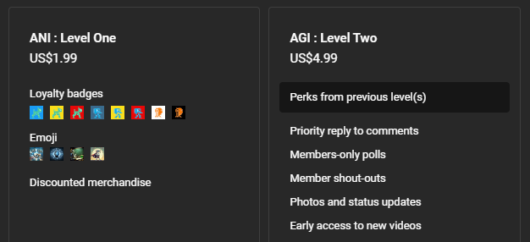

Membership has its privileges
Notes:
https://www.youtube.com/channel/UC35ZpwldGw7ZJ5R-2sLijzw/join

Slide 5
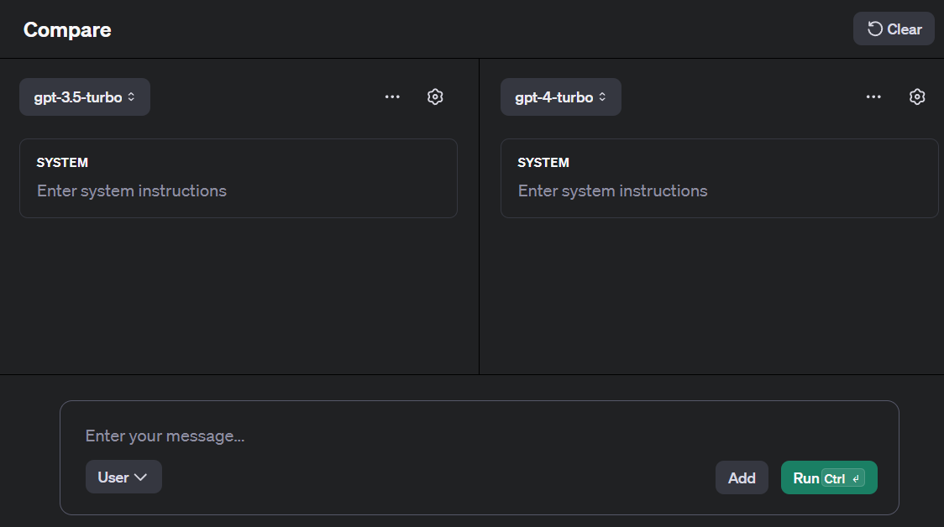

Slide 6
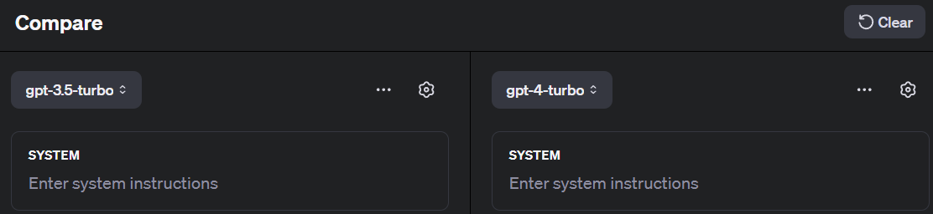
Demo: Testing Different Models

Slide 7
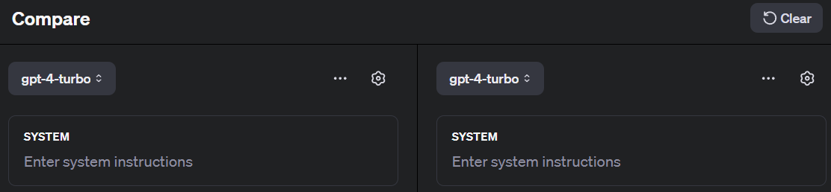
Demo: Testing the Same Model

Slide 8
